Slide 1
Positive Behavioral Intervention and Supports
Sarah Aylsworth
Grades 5-8

Slide 2
Discipline in a nutshell
Teacher hands out assignment and asks students to begin
Student puts head down and refuses to complete work
Student is written up for defiance and asked to leave class
We see this happen all the time. The frustration builds and consequences are laid out.
Is this the best practice?

Slide 3
What is PBIS?
Positive Behavioral Interventions and Support builds effective environments that teach appropriate behaviors to replace the use of inappropriate behavior.
PBIS focuses more on PREVENTING behaviors before needing to CONSEQUATE them.

Slide 4
Discipline – PBIS Style
Remember this example?
Teacher hands out assignment and asks students to begin
Student puts head down and refuses to complete work
Student is written up for defiance and asked to leave class
PBIS focusing on changing the culture of the school and teaching (and reteaching) appropriate behaviors before they happen. We need to focus more on the WHY. Why did the student put his head down? Is he feeling connected with his peers and teacher? Is he frustrated? Does he understand? Is his behavior truly defiant or is there something underlying?

Slide 5
Rationale
Why not?
It won’t eliminate all problems, but it has proven to reduce the frequency, duration and intensity of negative behaviors

Slide 6
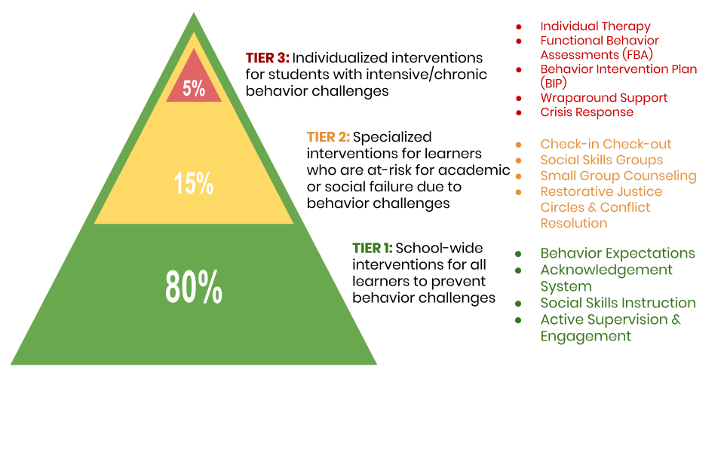
Key principles or ideas
Multi-tiered framework establishes systems of social-emotional and behavioral support .
Beneficial for ALL students.
Begin with strong universal supports followed by intensified interventions matched to student needs.
Data are collected and used to screen, monitor, and assess student progress.

Slide 7
School-Wide Implmentation
Create a “dream” team to lead PBIS implementation.
Identify and teach a few (3-5) schoolwide expectations
Develop a system to encourage appropriate behavior
Culture shift
Develop a system to discourage misbehavior
School-wide rules and discipline plan
Develop a system to track student progress
Reflect on implementation and impact of PBIS

Slide 8
Teacher - classroom Implementation
Create Classroom expectation
Connect your expected behavior with the school-wide expectation
They need to be
Observable
Measurable
Positive
Reinforceable
Teach and RE-teach routines
Build positive rapport
Carefully design and set-up classroom to minimize distraction and enhance proximity
Find opportunities to connect!

Slide 9
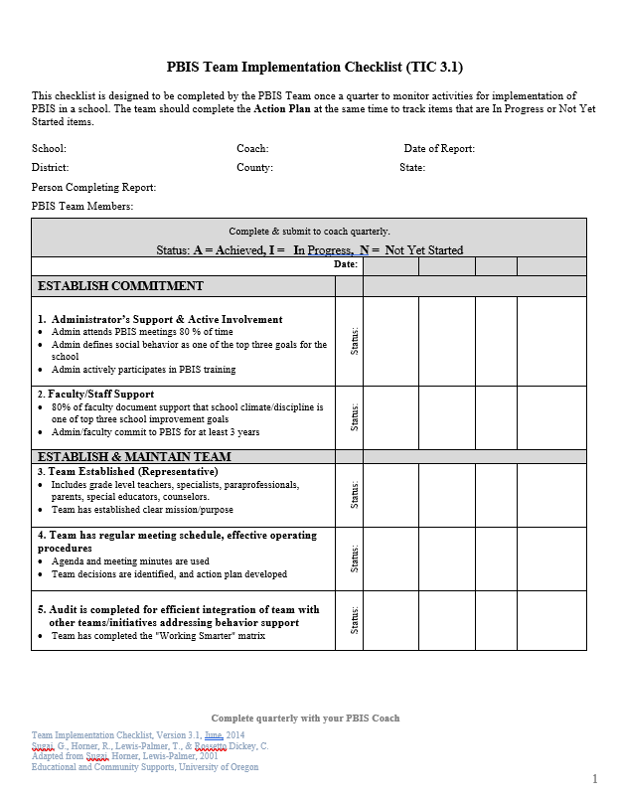
Reflection
Each quarter, the implementation team will conduct surveys and completing checklists to monitor the progress of the school.

