Slide 1
Social Emotional Learning
Sarah Aylsworth

Slide 2
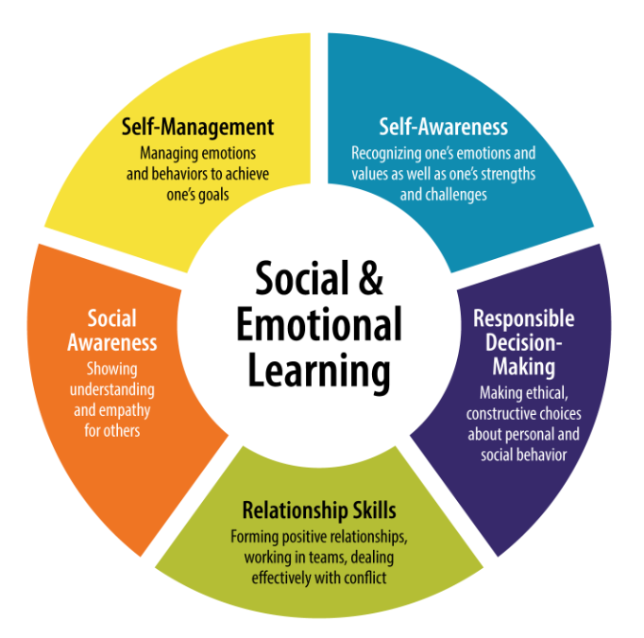
What is Social Emotional Learning (SEL)?

Slide 3
How is SEL Defined?
Social and emotional learning (SEL) provides the structure and environment for students to develop fundamental emotional and social competencies to:
understand and manage emotions,
set and achieve positive goals,
feel and show empathy for others,
establish and maintain positive relationships and
make responsible decisions.

Slide 4
CASEL’s Five Core Competencies
Self-awareness
The ability to accurately recognize one’s emotions and thoughts and their influence on behavior. This includes accurately assessing one’s strengths and limitations and possessing a well-grounded sense of confidence and optimism.
Self-management
The ability to regulate one’s emotions, thoughts, and behaviors effectively in different situations. This includes managing stress, controlling impulses, motivating oneself, and setting and working toward achieving personal and academic goals.
Social awareness
The ability to take the perspective of and empathize with others from diverse backgrounds and cultures, to understand social and ethical norms for behavior, and to recognize family, school, and community resources and supports.
Relationship skills
The ability to establish and maintain healthy and rewarding relationships with diverse individuals and groups. This includes communicating clearly, listening actively, cooperating, resisting inappropriate social pressure, negotiating conflict constructively, and seeking and offering help when needed.
Responsible decision-making
The ability to make constructive and respectful choices about personal behavior and social interactions based on consideration of ethical standards, safety concerns, social norms, the realistic evaluation of consequences of various actions, and the well-being of self and others

Slide 5
Rationale
Why not?
Remember back to your school days….
Wouldn’t it have been more meaningful to be in an environment where you felt safe, appreciate, accepted and loved?
As an adult, wouldn’t you have appreciated attending a school that taught you social awareness, effective coping skills and goal setting in a caring and patient way?
It won’t eliminate all problems, but it has proven to actively involve students in their social, emotional and academic growth.

Slide 6
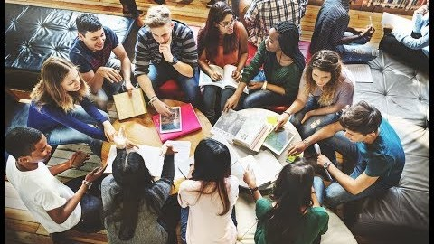
Does it work?

Slide 7
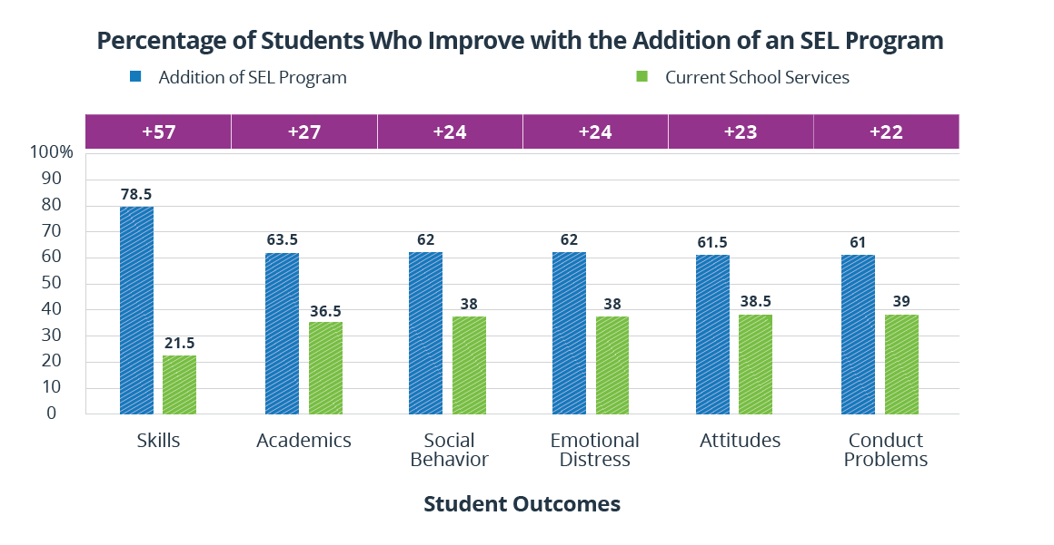
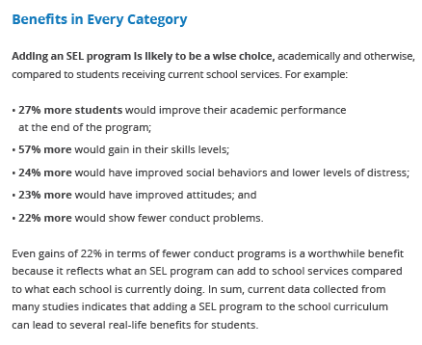
What do we know? The Facts and Figures…

Slide 8
Our Guiding Principles
Teaching social skills is as important as teaching academic content.
How you teach is as important as What you teach.
Great learning takes place when kids interact with each other.
Teacher teamwork is key.
Connect before you correct.
Use parents as the valuable tool they are.

Slide 9
School Culture Shift
School culture and climate affect students’ behavior and attitudes.
And….students’ behavior and attitudes affect school culture and climate.

Slide 10
School Implications
Formation of a SEL Resource Team
Addressing and discussing building climate
Modeling of social and emotional competence
Developing new school norms and values
Developing a fair and equitable discipline policy that addresses bullying prevention
Providing student support services
Learning specialist
Counselor
Advisors
Change scheduling to building in daily class meetings
Fostering schoolwide activities that promote positive school environment

Slide 11
Classroom implications
SEL trainings
Daily class meetings
Teaching and modeling social and emotional skills
Providing opportunities for students to practice and hone those skills
Giving students an opportunity to connect with each other daily, outside of the academic rigors of the classroom
Embedding SEL instruction in content areas by using Universal Design Learning
Focus on building interpersonal relationships with students
Changing to a “student first” mentality
Providing emotional support and autonomy to ALL students

Slide 12
Morning Meetings
Morning meetings allow your class to begin each day as a community of caring and respectful learners. The meeting merges academic, social and emotional learning. It motivates students by addressing the human need to feel a sense of significance and belonging, and to have fun.

Slide 13
Components of a Morning Meeting
Greeting - Students greet each other by name, often including handshaking, singing, movement, and other activities, dependent on time.
Sharing - Students share some teacher-directed information about themselves and respond to each other, articulating their thoughts, feelings, and ideas positively.
Group Activity - The whole class does a short, inclusive activity together, reinforcing learning and building class cohesion through active participation.
Morning Message - Students practice academic skills and warm up for the day ahead by reading and discussing a daily note to the class posted by the teacher.

Slide 14
Take Away
Science Links SEL to Student Gains:
Better social-emotional skills
Improved attitudes about self, others, and school
Positive classroom behavior
11 percentile-point gain on standardized achievement tests
Fewer conduct problems
Less emotional stress
Lower drug use
…and adults benefit too
Teachers who possess social and emotional competencies are more likely to stay in the classroom longer because they’re able to work more effectively with challenging students —one of the main causes of burnout.
Statistically significant associations between measured social-emotional skills in kindergarten and key young adult outcomes across multiple domains of education, employment, criminal activity, substance use, and mental health.

Slide 15
Employers Value SEL
Of surveyed executives say skills such as problem-solving and communicating clearly are equally or more important than technical skills
National Bureau of Economic Research, 2015
92%
The Top 10 skills identified by the World Economic Forum all involve social and emotional competence.
Source: Future of Jobs Report, World Economic Forum
Complex problem solving
Critical thinking
Creativity
People management
Coordinating with others
Emotional intelligence
Judgment and decision-making
Service orientation
Negotiation
Cognitive flexibility

Slide 16
What kind of Student do we want to send out into the world?

Slide 17
Additional Resources
Collaborative for Academic, Social, and Emotional Learning (CASEL)
Responsive Classroom
Durlak, J. A., Domitrovich, C. E., Weissberg, R. P., & Gullotta, T. P. (2017). Handbook of Social and Emotional Learning: Research and Practice. New York, NY: Guilford Press.
Merrell, K.W. & Gueldner, B.A. (2010). Social and emotional learning in the classroom: Promoting mental health and academic success. New York: Guilford Press.

